Slide 1
A Conceptual Approach to Address Anthropogenic / Non-Anthropogenic Emission Sources to Help Develop a More Accurate Regional Haze Program Glidepath
Control # 55
Presented at the A&WMA Conference
Atmospheric Optics: Aerosols, Visibility, and the Radiative Balance
September 27-30, 2016, Jackson Hole WY
Title slide
Ou Nopmongcol
Ralph Morris
Cassie Archuleta
Emily Vanden Hoek
Joe Adlhoch
Notes:
Title slide

Slide 2
Regional haze rule
Established by EPA in 1999 (40 CFR Part 51 Sections 308 & 309)
Requires States to develop Implementation Plans (SIPs) to provide protection for Federal Class I Areas
Establish Reasonable Progress goals toward achieving Natural Conditions by the year 2064
Natural Conditions are defined as visibility conditions that would be experienced absent human-caused impairment
Periodic SIP updates are due every 10 years
The next one is due in 2021 with 2028 milestone

Slide 3
Amendments to the RHR
Proposed on April 25, 2016
Extend the requirements to all states (reasonably attributable visibility impairment, RAVI)
The 2nd planning period would remain 2028
Interim progress report deadlines : Jan/2025, Jul/2033, every 10 yrs
Visibility Impairment due to anthropogenic impacts
Account for International emissions
EPA provided a draft guidance on June 30, 2016
Notes:
Progress reports: early Consultation with FLM; reviewed by EPA

Slide 4
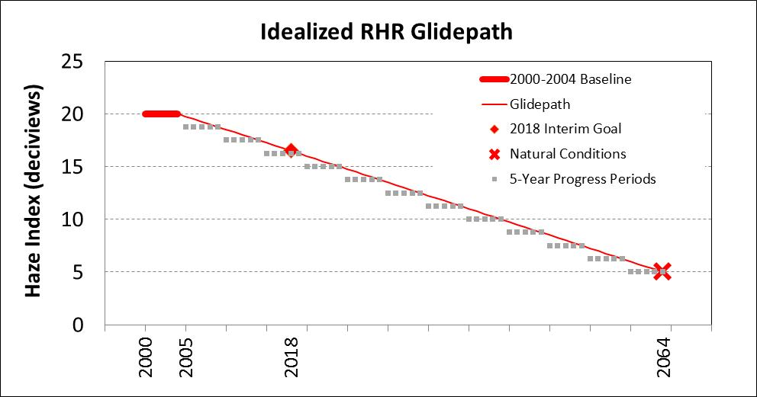
Uniform rate of progress (URP) GLIDEPATH
EPA provided concept of linear progress toward 2064 visibility goal calculated using IMPROVE network data
Current Conditions
(most recent 5-year period of fully validated data)

Slide 5
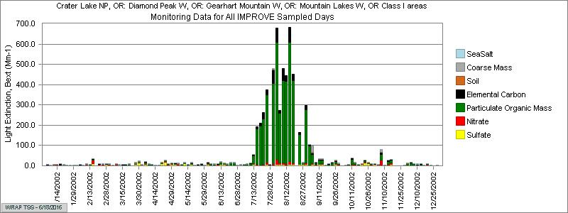
Regional haze rule glidepath
Regional Haze Rule (as in first implementation period 2000-2018)
Progress toward natural conditions for Worst 20 percent (W20%) based on IMPROVE measurements
In western U.S. W20% days frequently dominated by wildfires and windblown dust
For “natural” conditions:
Default estimates use broad regional averages that do not consider natural episodic events such as wildfires and dust transport (Trijonis)

Slide 6
CENSARA RHR Glidepath
Motivation: Human-caused impairment v.s. Controllable sources
Objective: Provide recommendations regarding how to account for the impact of uncontrollable sources on the glidepath
Factors evaluated include:
Definitions of controllable vs. uncontrollable sources
Attribution methods
RHR glidepath recommendations, including:
Modifications to treatment of “Natural Conditions”
Characterization of large episodic natural events (e.g., wildfires and dust storms)
Calculation of 20% most impaired/least impaired days

Slide 7
Attribution method
IMPROVE measurements cannot distinguish between controllable and uncontrollable contributions
Statistical methods to filter high OC/EC (fires) or Crustal (WBD)
Receptor modeling (CMB, PMF, Unmix)
Screening (“Exceptional Events”)
Photochemical grid models (PGMs)
Source apportionment algorithms track contributions from all sources with accurate distinction of natural vs anthropogenic emissions
Hybrid method: combined elements of PGM and observation
use CAMx PSAT visibility analysis data to scale the source contributions to match the IMPROVE measurements by species
previous studies: CENRAP, WRAP TSS, WAQMS 2008, WAQS 2011 analysis (Ralph Morris: Control #116)
Notes:
accurate distinction of natural versus anthropogenic emissions contributions provided the source categories can be so divided
CMB - constrained models that use source signatures to decompose the observed PM_{2.5} to source contributions
PMF - decompose the observed PM_{2.5} into a series of factors than may be able to be matched to a source type

Slide 8
Proposed METHODOLOGY
Generate PGM mass attribution results
Separately for controllable and uncontrollable sources
Use PSAT visibility attribution data to scale the source contributions to match the IMPROVE measurements by species on a daily basis
Controllable: %Controllable (from PSAT) * measured (from IMPROVE)
Uncontrollable: %Uncontrollable (from PSAT) * measured (from IMPROVE)
Use PSAT weighted “uncontrollable” as a more attainable 2064 goal than default natural conditions
Accounts for natural emissions and international transport
Notes:
Tracking reasonable progress with the influence of large episodic natural events is problematic

Slide 9
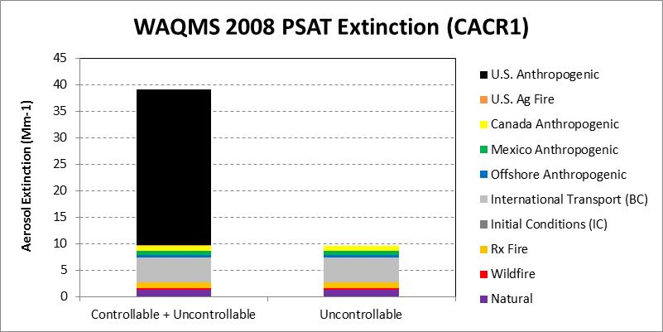
Controllable vs. uncontrollable in the pSAt modeling exercises
Uncontrollable
Natural (Bio, LNOx, SS, WBD)
All Non-US Fires
US Wild and prescribed Fires
Canada
Mexico
BCs/ICs
Offshore shipping?
Controllable:
US Anthropogenic
US Agricultural Fires
Example results from 2008 PSAT
Content slide
Notes:
This slide has animation

Slide 10
Controllable vs. uncontrollable contributions to aerosol extinction
Colors show US Anthropogenic
Fraction from “uncontrollable” sources, determined using PSAT

Slide 11
ALTERNATIVE Determination OF MOST and LEAST IMPAIRED DAYS
Exclude vs Substitute
Substitute outliers (e.g., Boylan method) for “Background” conditions (2064):
Calculate average quarterly median between 2004-2008
Replace OMC+EC (TC) and CM for values > 5*Median (quarterly) with median values
Recalculate 20% worst days from the “uncontrollable” portion of the 2008 measurements
Large events at CenSARA sites in 2008
CM: BIBE1 site (2 days) and the GUMO1 site (6 days).
TC: No CenSARA sites met the criteria for substitution
Similar methodology for “Baseline” and “Current” conditions
Notes:
95% vs annually medians - so including more days that are not only 95% of 14 years
For this exercise, episode screening is only applied to 2064 end point

Slide 12
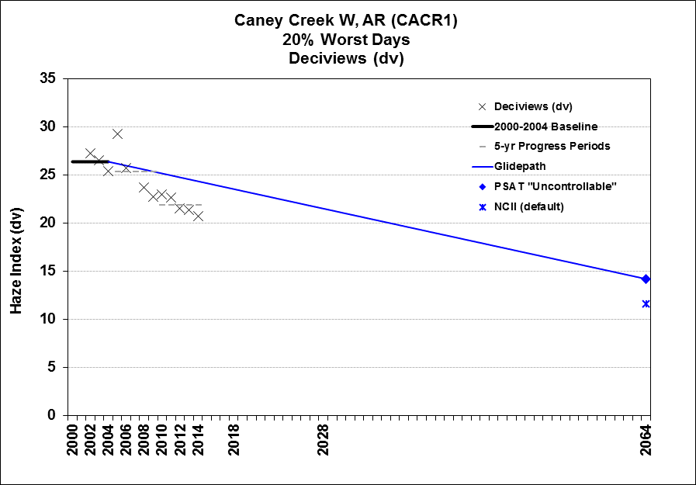
Glideslope – Example Plots

Slide 13
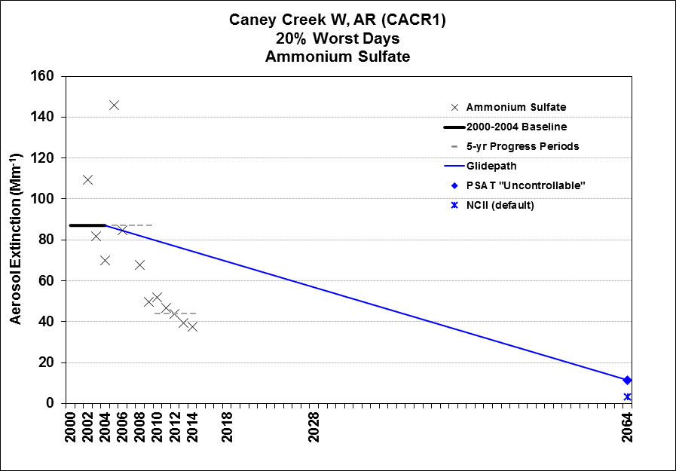
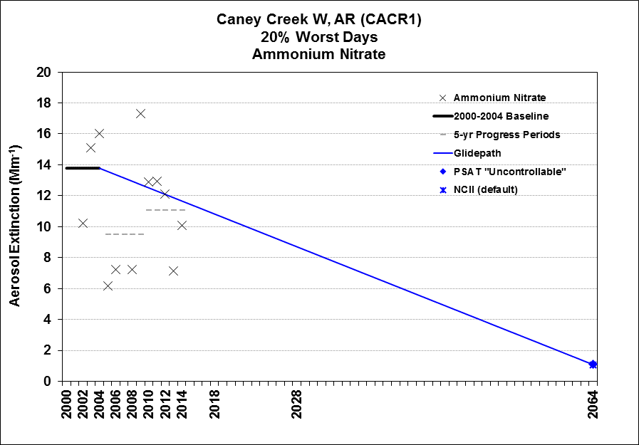
Glideslope – Example Plots

Slide 14
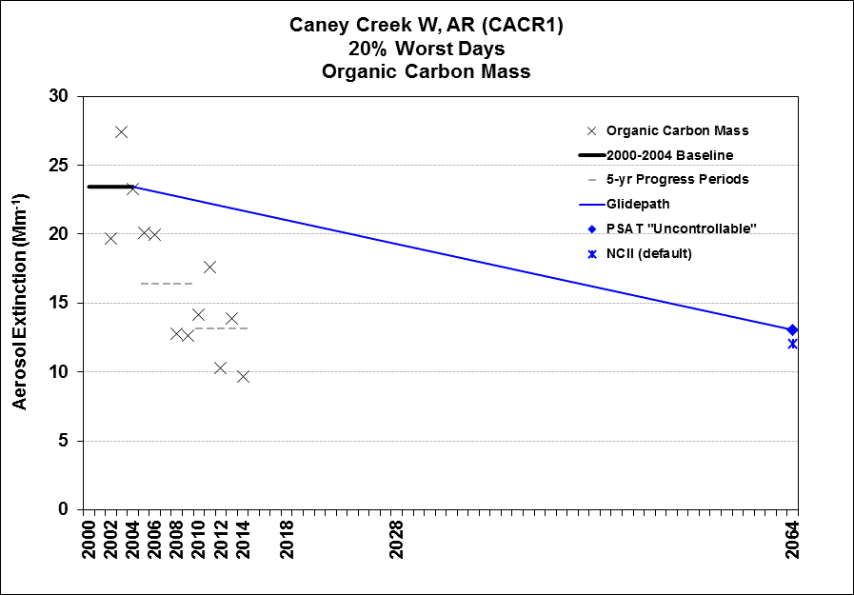
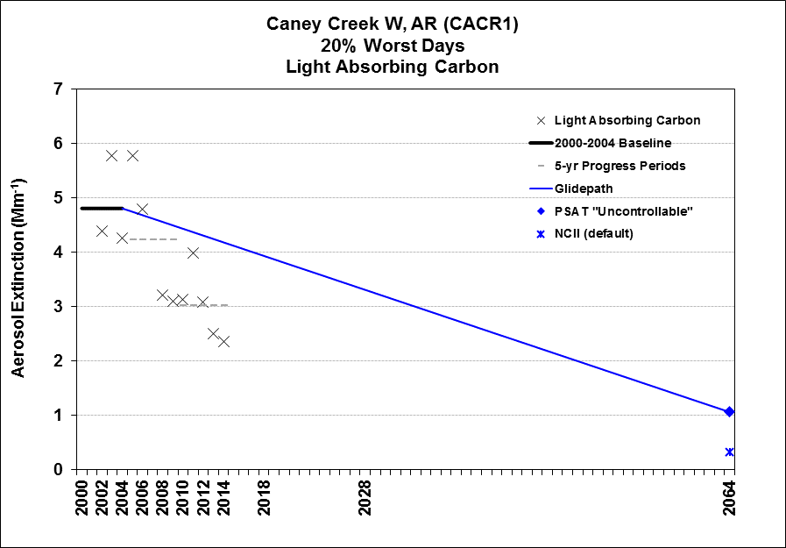
Glideslope – Example Plots

Slide 15
CONCLUSION
“… modeling is one possible technique for determining that reasonably attributable visibility impairment is occurring” 40 CFR Parts 51 and 52
Advantages:
Consistent assumptions for all points along glidepath (e.g., meteorological conditions, emissions profiles, etc.)
Daily distribution for “uncontrollable” 2064 goal allows for determination of 20% best and 20% worst days
2064 goal can be updated with each 10-year SIP
Considerations and refinements:
Detailed model performance evaluation is crucial
Identification and treatment of large natural events is subjective
Similar analysis can be done for 20% most impaired days (Thursday: 9B)
Zero-anthropogenic simulation to set 2064 goals
Notes:
Takes advantage of evolving and changing characterization of natural and background emissions (e.g., biogenic, dust, etc.)

Slide 16
Thank you

